Slide 1
Azure Fundamentals

Slide 2
Lesson Objectives
At the end of this module you will be able to:
Understand the fundamentals of Microsoft Azure
Get an overview of Azure services
Get an idea of Azure portal and its navigation

Slide 3
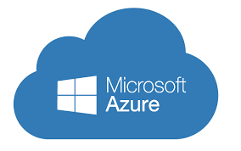
Microsoft Azure
Microsoft Azure is a comprehensive cloud platform that enables solutions based on individual challenges and needs - with the benefits of a public cloud service.
Azure can be described as a growing collection of integrated cloud services that developers and IT professionals can use to build, deploy, and manage applications through a global network of datacenters.
Notes:
It is introduced as Windows Azure and renamed as Microsoft Azure in 2014.
With Azure, you get the freedom to build and deploy wherever you want, using the tools, applications, and frameworks of your choice. You can store data using relational SQL databases, NoSQL table stores, and unstructured blob storages, and optionally use Hadoop and business intelligence services to data-mine it. You can take advantage of Microsoft Azure’s robust capabilities to enable scalable distributed applications, as well as deliver hybrid solutions that run across a cloud and on-premise enterprise environment.
Microsoft Azure can provide a bridge from your data center to the cloud.

Slide 4
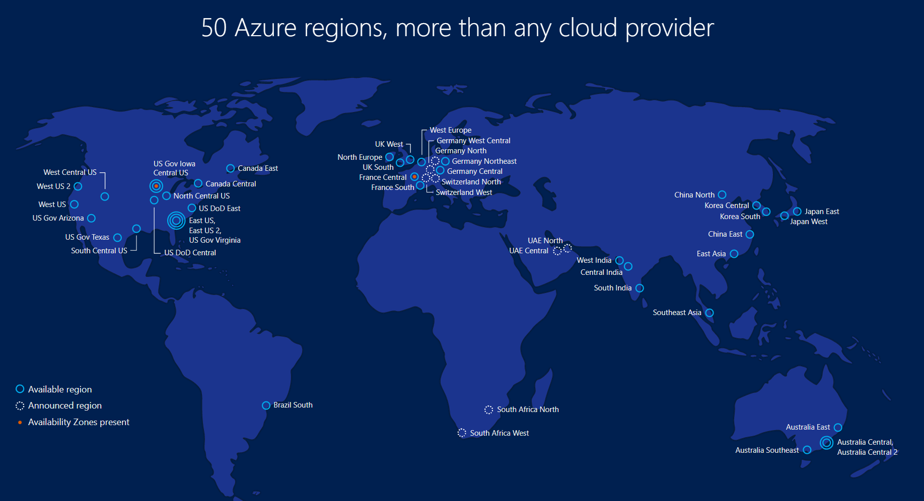
Azure Datacenters
Source: azure.microsoft.com
Notes:
Regions
A region is a set of datacenters deployed within a latency-defined perimeter and connected through a dedicated regional low-latency network.
With more global regions than any other cloud provider, Azure gives customers the flexibility to deploy applications where they need to.
Geographies
A geography is a discrete market, typically containing two or more regions, that preserves data residency and compliance boundaries. Geographies allow customers with specific data-residency and compliance needs to keep their data and applications close. Geographies are fault-tolerant to withstand complete region failure through their connection to our dedicated high-capacity networking infrastructure.
Availability Zones
Availability Zones are physically separate locations within an Azure region. Each Availability Zone is made up of one or more datacenters equipped with independent power, cooling, and networking. Availability Zones allow customers to run mission-critical applications with high availability and low-latency replication.

Slide 5
Azure Data Centers
The core architectural components of Azure may be broken down into two main groupings: the physical infrastructure, and the management infrastructure.
The physical infrastructure for Azure starts with datacenters.
As a global cloud provider, Azure has datacenters around the world. However, these individual datacenters aren’t directly accessible. Datacenters are grouped into Azure Regions or Azure Availability Zones

Slide 6
Azure Data Centers
Regions
A region is a set of datacenters deployed within a latency-defined perimeter and connected through a dedicated regional low-latency network.
With more global regions than any other cloud provider, Azure gives customers the flexibility to deploy applications where they need to.
Geographies
A geography is a discrete market, typically containing two or more regions, that preserves data residency and compliance boundaries. Geographies allow customers with specific data-residency and compliance needs to keep their data and applications close. Geographies are fault-tolerant to withstand complete region failure through their connection to our dedicated high-capacity networking infrastructure.
Availability Zones
Availability Zones are physically separate locations within an Azure region. Each Availability Zone is made up of one or more datacenters equipped with independent power, cooling, and networking. Availability Zones allow customers to run mission-critical applications with high availability and low-latency replication

Slide 7
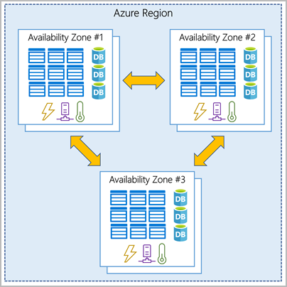
Availability Zone
An availability zone is set up to be an isolation boundary. If one zone goes down, the other continues working. Availability zones are connected through high-speed, private fiber-optic networks.

Slide 8
Availability Sets
An Availability Set is a logical grouping capability for isolating VM resources from each other when they’re deployed.
When you deploy new virtual machines (VMs), Azure, by default, does not possess the necessary information to identify dependencies among them.
Hence, this may lead to a single point of failure in the hosted service due to an unexpected hardware fault or a maintenance operation.
It guarantees that the VMs included in the same group are isolated from each other.
Availability Sets are based on two logical groupings:
fault domains and update domains.
Microsoft gives 99.95% SLA if you deployed your VMs in Availability Set..

Slide 9
Availability Sets
Availability Sets are based on two logical groupings:
fault domains and update domains.
The best practice is to create one Availability Set per workload(as a set of servers that work together running the same service
Microsoft gives 99.95% SLA if you deployed your VMs in Availability Set..

Slide 10
Azure management infrastructure
The management infrastructure includes Azure resources and resource groups, subscriptions, and accounts.

Slide 11
Azure resources and resource groups
A resource is the basic building block of Azure.
Anything you create, provision, deploy, etc. is a resource.
E.g. Virtual Machines (VMs), virtual networks, databases

Slide 12
Knowledge Check
1.
How many resource groups can a resource be in at the same time?
Solutions:
One
Two
Three
2.
What happens to the resources within a resource group when an action or setting at the Resource Group level is applied?
1.Current resources inherit the setting, but future resources don’t.
2.Future resources inherit the setting, but current ones don’t.
3.The setting is applied to current and future resources.

Slide 13
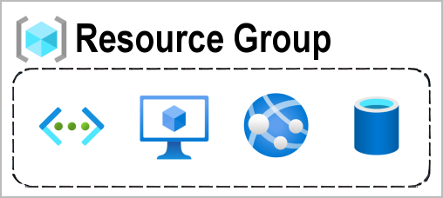
Resource Group
Resource groups are simply groupings of resources

Slide 14
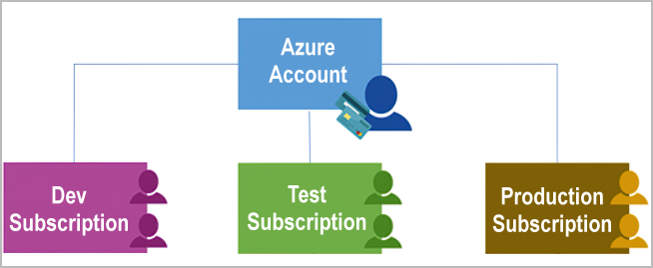
Azure subscriptions
In Azure, subscriptions are a unit of management, billing, and scale. Similar to how resource groups are a way to logically organize resources, subscriptions allow you to logically organize your resource groups and facilitate billing.

Slide 15
Azure subscriptions
A subscription provides you with authenticated and authorized access to Azure products and services.
It also allows you to provision resources.
An Azure subscription links to an Azure account, which is an identity in Azure Active Directory (Azure AD) or in a directory that Azure AD trusts.

Slide 16
Benefits of Microsoft Azure
Azure
Reliable and secure
Quick and easy deployment
Pay only for what you use
Worldwide datacenters
Unlimited storage and capacity
Flexible & Scalable

Slide 17
Azure Portal
The Azure portal is probably the most common and initially the most approachable way to interact with Azure.
The portal gives you access to all your resources on Azure and all features of Azure can be accessed through it. You can, using Microsoft's words, "Build, manage, and monitor everything from "simple web apps to complex cloud applications "in a single, unified console.
Access control, you can choose who has access to resources with very great accuracy. This is important to manage and govern your Azure resources effectively

Slide 18
Azure CLI
Azure Command Line Interface.
It is a text-only entry tool, also known as a command line interface –
An interface you only type commands into.
In the CLI, you use a command like 'az vm create', all typed out, to create a VM.
The CLI is a tool used a lot by Azure professionals for a few reasons.
Because commands change rarely, you can automate actions using the Azure CLI commands.

Slide 19
Azure Portal
The Azure portal is probably the most common and initially the most approachable way to interact with Azure.
The portal gives you access to all your resources on Azure and all features of Azure can be accessed through it. You can, using Microsoft's words, "Build, manage, and monitor everything from "simple web apps to complex cloud applications "in a single, unified console.
Access control, you can choose who has access to resources with very great accuracy. This is important to manage and govern your Azure resources effectively
It is a great visual way to manage Azure resources, and you will be using it a lot.

Slide 20
PowerShell
PowerShell is a command line interface as well, and it is text-based 100%.

Slide 21
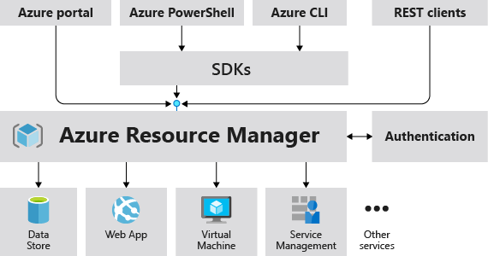
Azure Resource Manager
Azure Resource Manager is the deployment and management service for Azure.
It enables you to create, update, and delete resources in your Azure account.

Slide 22
Advantages of ARM
Consistency
Modularity
Automation
Tagging

Slide 23
ARM Template
A block of code that defines the infrastructure and configuration for your project.
These templates use a declarative syntax to let you define your deployment in the form of JSON (JavaScript Object Notation) files.
All the resources and their properties are defined in this template. This helps in automating the deployment process in a constant flow.

Slide 24
Azure Services
The world of Azure is large and changes fast.
Monitoring
Security
Database
App Service
Compute
Network
Storage

Slide 25
Azure Storage Service
Blob
REST-based object storage for unstructured data
Table
NoSQL key-value store using semi-structured datasets
Queue
Used to create queue in the cloud and post and read messages from it
Storage
File
File shares that use the standard SMB 3.0 protocol
Backup
Used to take backup either on-premise VM or Azure VM with cloud-based backup as a service
Site Recovery
Used to replicate the work loads to disaster recovery data center or Azure storage
Notes:
SMB Stands for "Server Message Block." SMB is a network protocol used by Windows-based computers that allows systems within the same network to share files.

Slide 26
Azure Network Service
Virtual Network
Provision private networks, optionally connect to on-premises datacenters
Load Balancer
Deliver high availability and network performance to your applications
Application Gateway
Build secure, scalable, and highly available web front ends in Azure
Network
Traffic Manager
Route incoming traffic for high performance and availability
Express Route
Used to connect private data centers to cloud in a private connection mode
VPN
It delivers the same functionality like Express Route but over the internet
DNS
Host your DNS domain in Azure

Slide 27
Azure Compute Service
Virtual Machine
Is a IaaS offering from Azure with that we can create servers using in-built or own images
Cloud Service
Classical way of deploying application along with the infrastructure
Compute
Service Fabric
Develop microservices and orchestrate containers on Windows or Linux
Container Instances
Easily runs container in a single command
Functions
Process events with serverless code

Slide 28
Azure Databases
SQL DB
Managed relational SQL Database as a service
SQL Data Warehouse
Elastic data warehouse as a service with enterprise-class features
SQL Stretch DB
Dynamically stretch on-premises SQL Server databases to Azure
Databases
Cosmos DB
Globally distributed, multi-model database for any scale
Redis Cache
Power applications with high-throughput, low-latency data access
Data Factory
Orchestrate and manage data transformation and movement
Notes:
SQL Data Warehouse is a cloud-based Enterprise Data Warehouse (EDW) that leverages Massively Parallel Processing (MPP) to quickly run complex queries across petabytes of data.
Azure Data Factory service is a fully managed service for composing data storage, processing, and movement services into streamlined, scalable, and reliable data production pipelines. Developers can use Data Factory to transform semi-structured, unstructured and structured data from on-premises and cloud sources into trusted information
Azure Redis Cache is based on the popular open-source Redis cache. It is typically used as a cache to improve the performance and scalability of systems that rely heavily on backend data-stores. Performance is improved by temporarily copying frequently accessed data to fast storage located close to the application. With Redis cache, this fast storage is located in-memory with Redis Cache instead of being loaded from disk by a database.

Slide 29
Azure App Services
Web Apps
Quickly create and deploy mission critical Web apps at scale
Mobile Apps
Build and host the backend for any mobile app
App Services
Logic Apps
Automate the access and use of data across clouds without writing code
API Apps
Easily build and consume Cloud APIs
Content Delivery Network
Ensure secure, reliable content delivery with broad global reach

Slide 30
Azure Security
Azure AD
Synchronize on-premises directories and enable single sign-on
Key Vault
Safeguard and maintain control of keys and other secrets
Security
Security Center
Unify security management and enable advanced threat protection across hybrid cloud workloads
Azure B2C
Consumer identity and access management in the cloud
Multi Factor Authentication
Add security for your data and apps without adding hassles for users

Slide 31
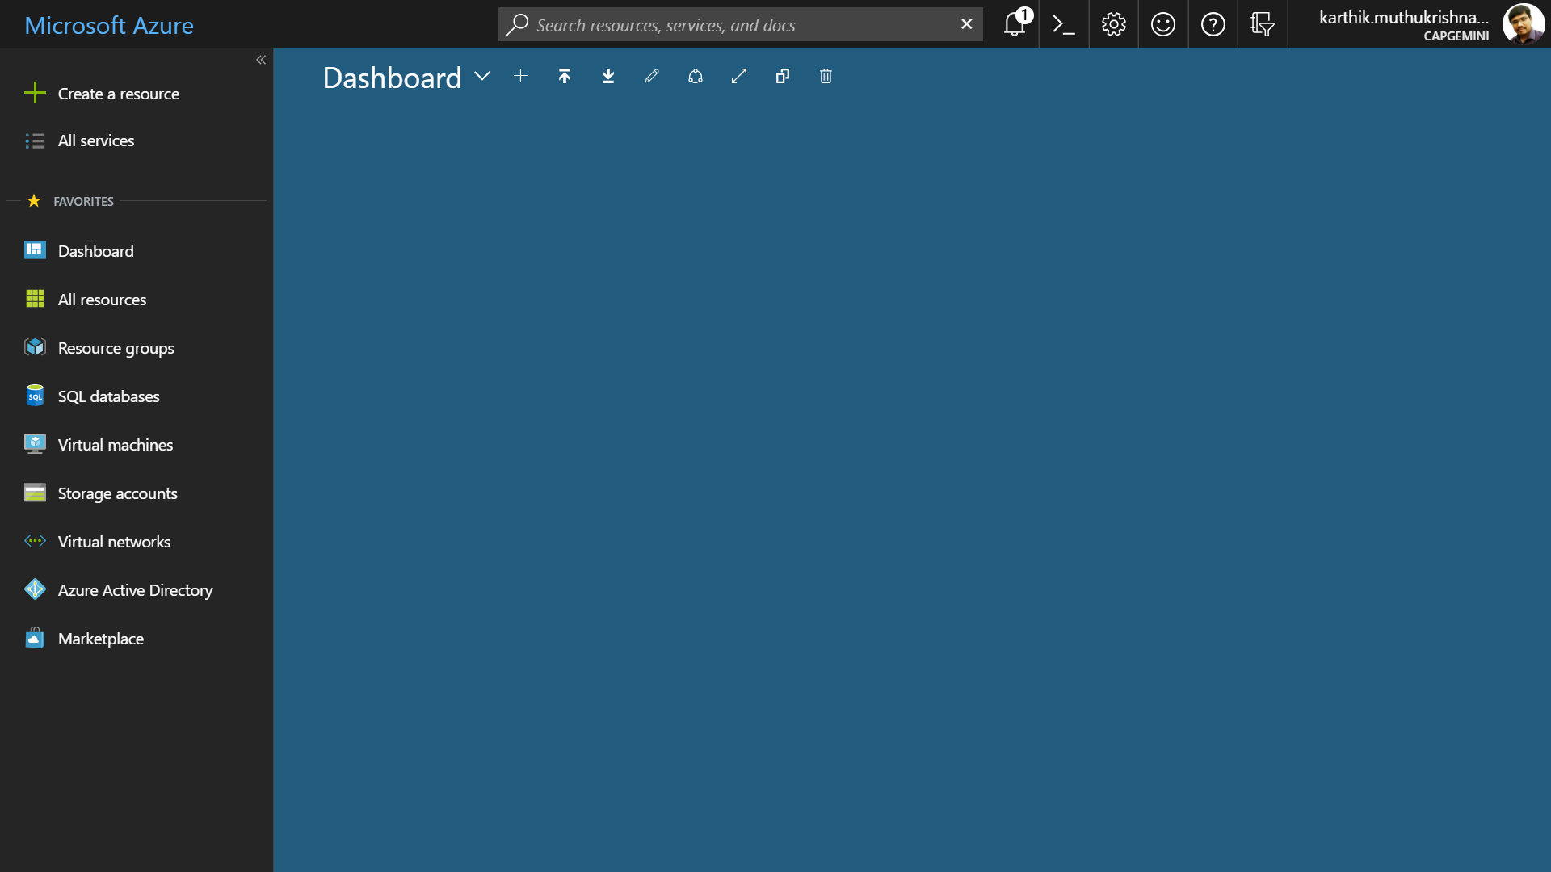
Microsoft Azure Portal
Azure portal helps us to view and manage all of your applications in one unified hub
portal.azure.com

Slide 32
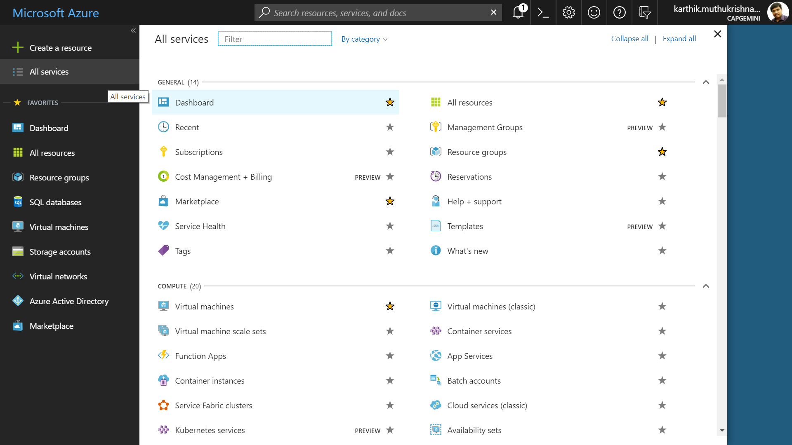
Accessing All the Services

Slide 33
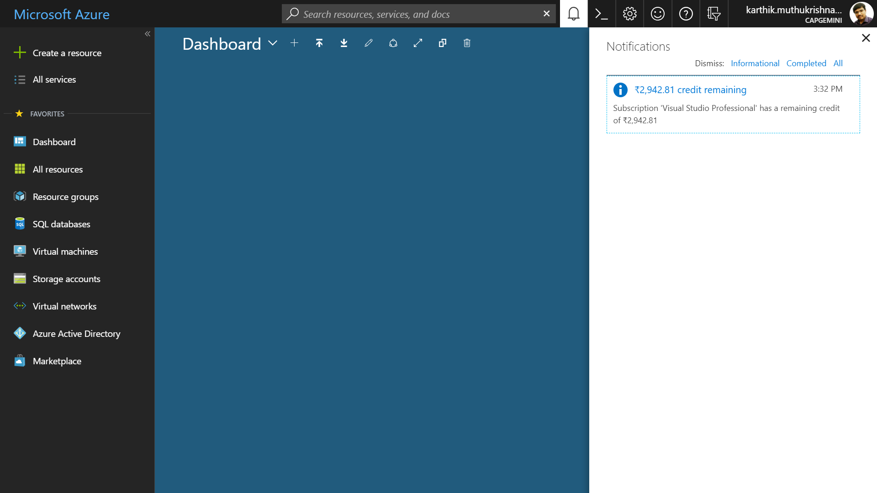
Notification Icon

Slide 34
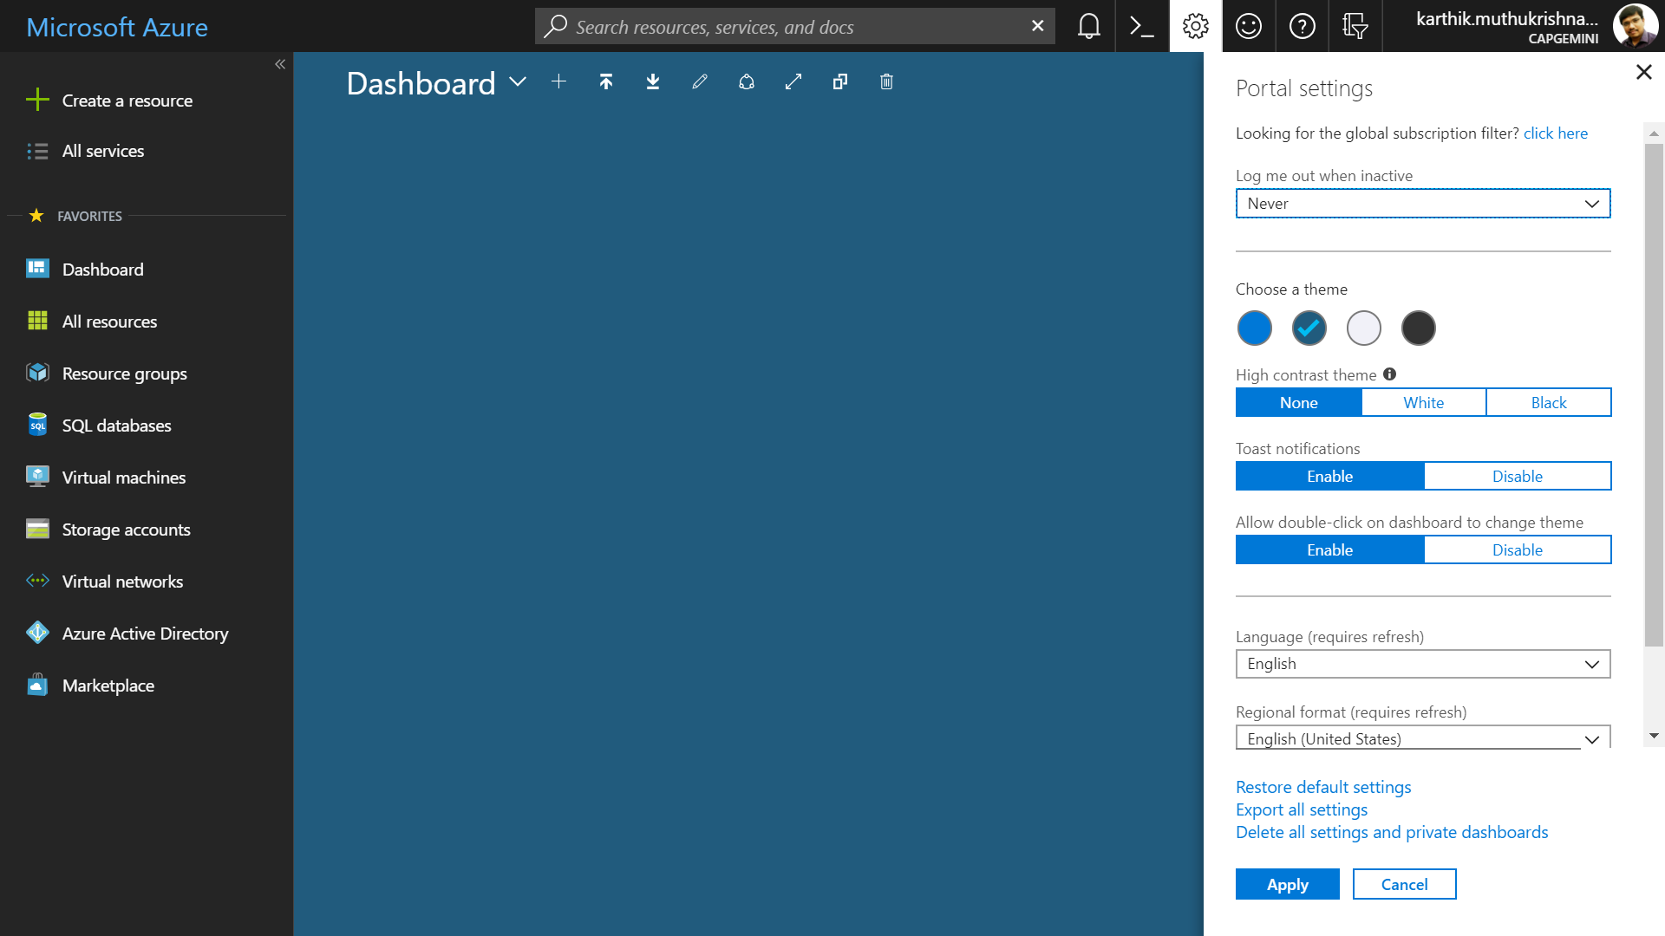
Portal Settings

Slide 35
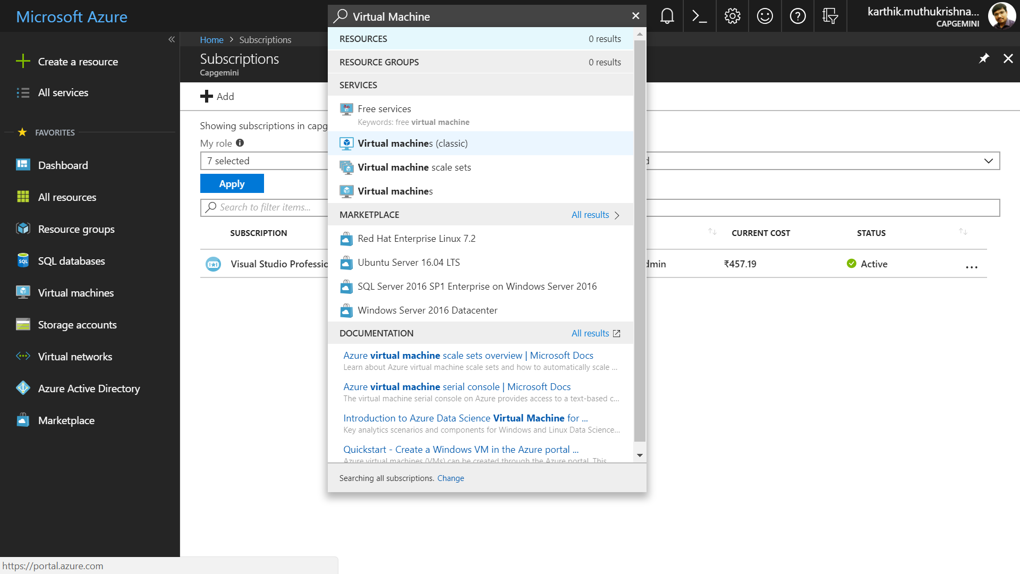
Azure Search(resources, services, and docs)

Slide 36
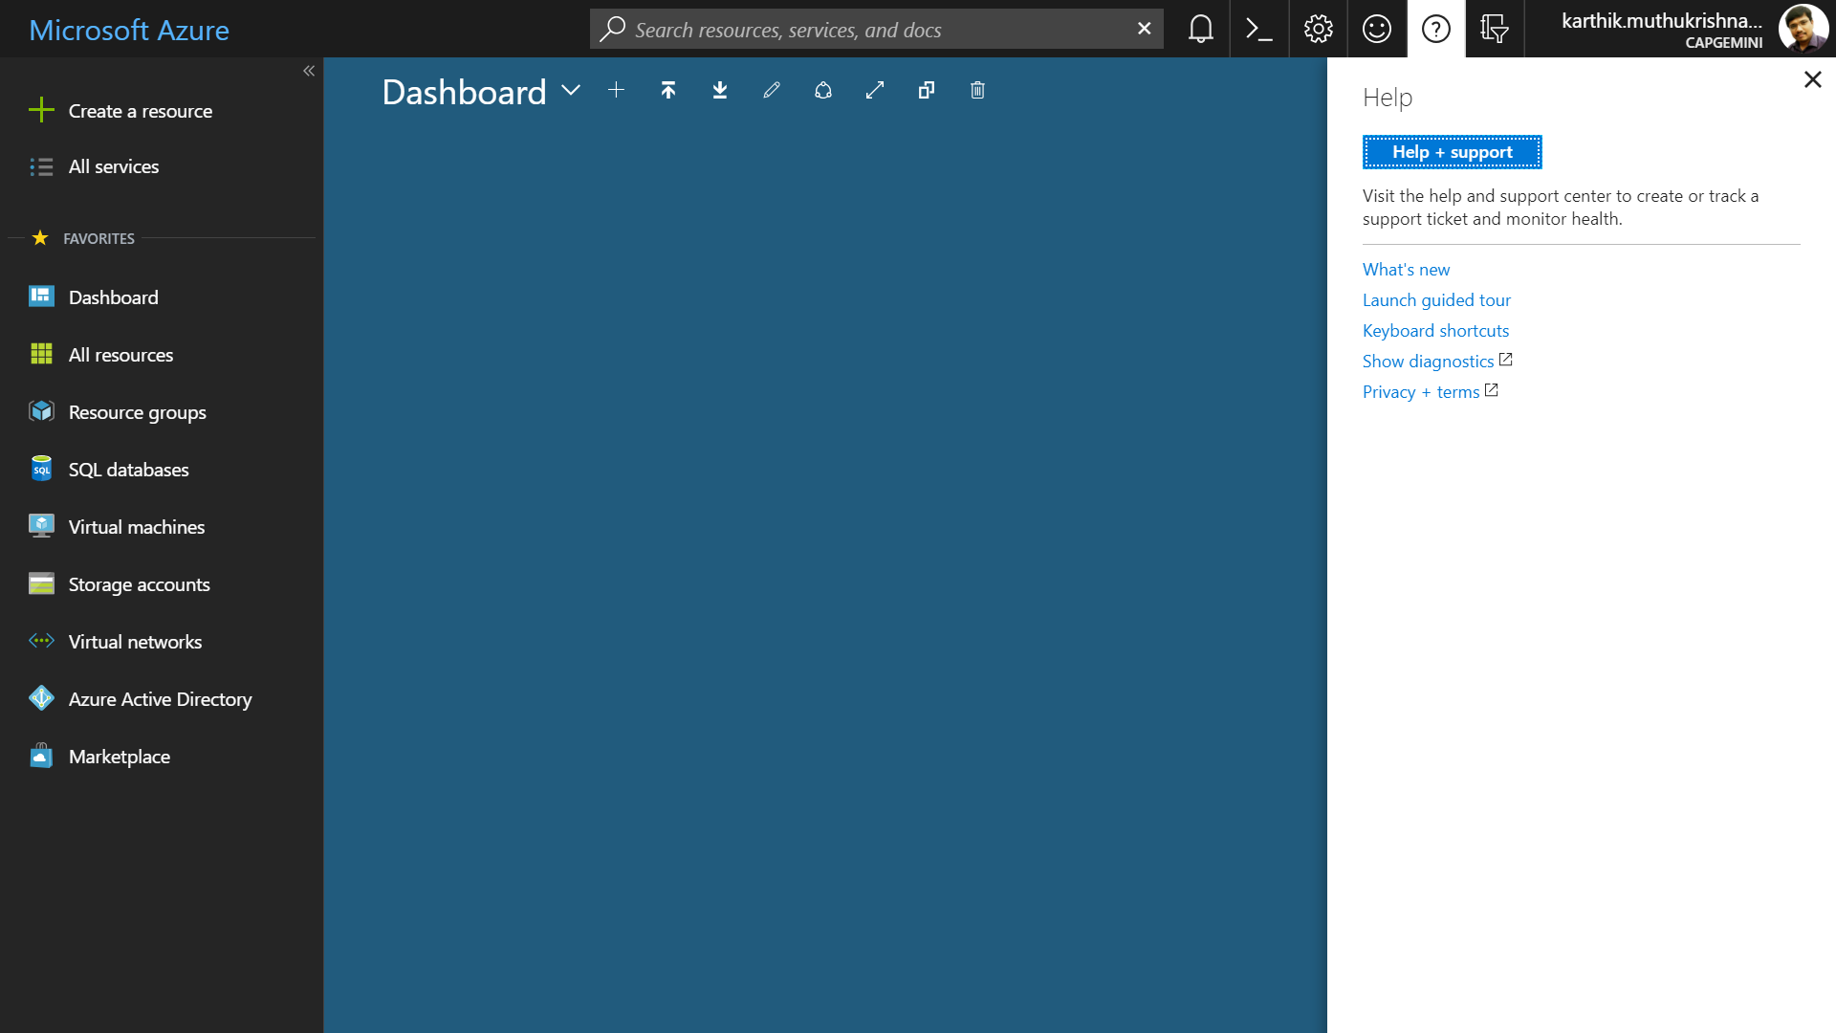
Azure Portal Help

Slide 37
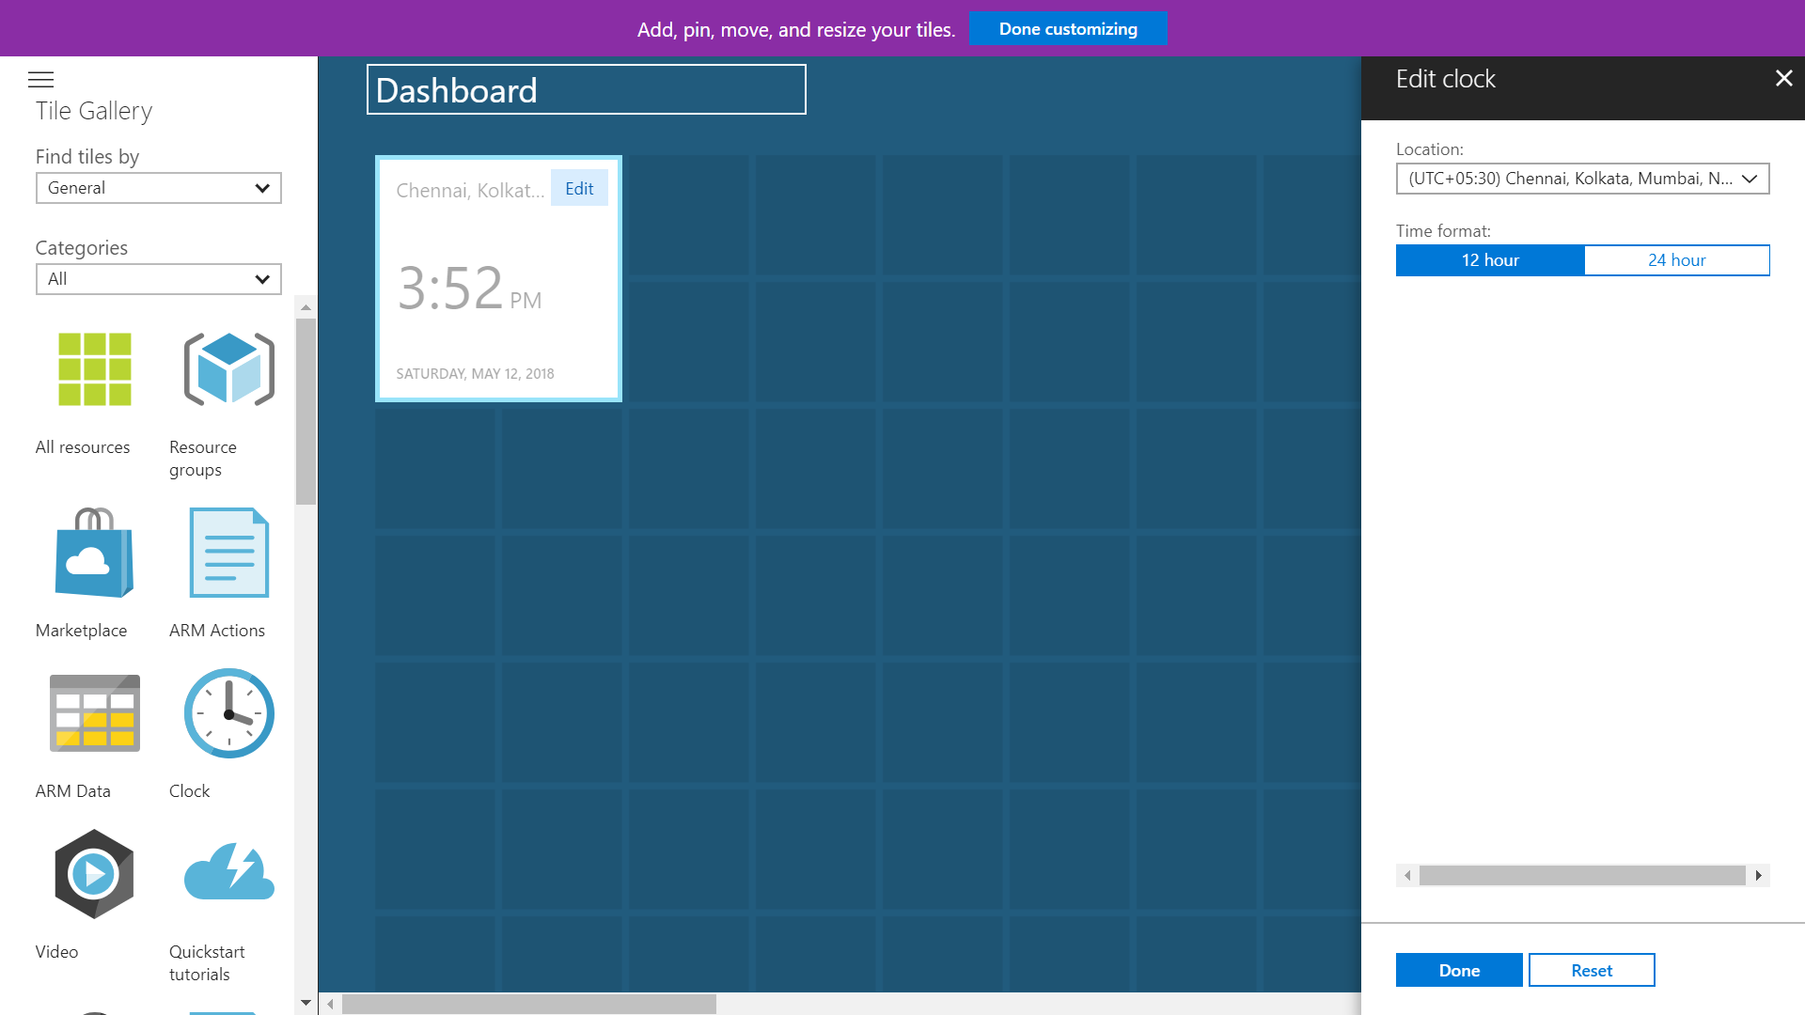
Editing Azure Dashboard

Slide 38
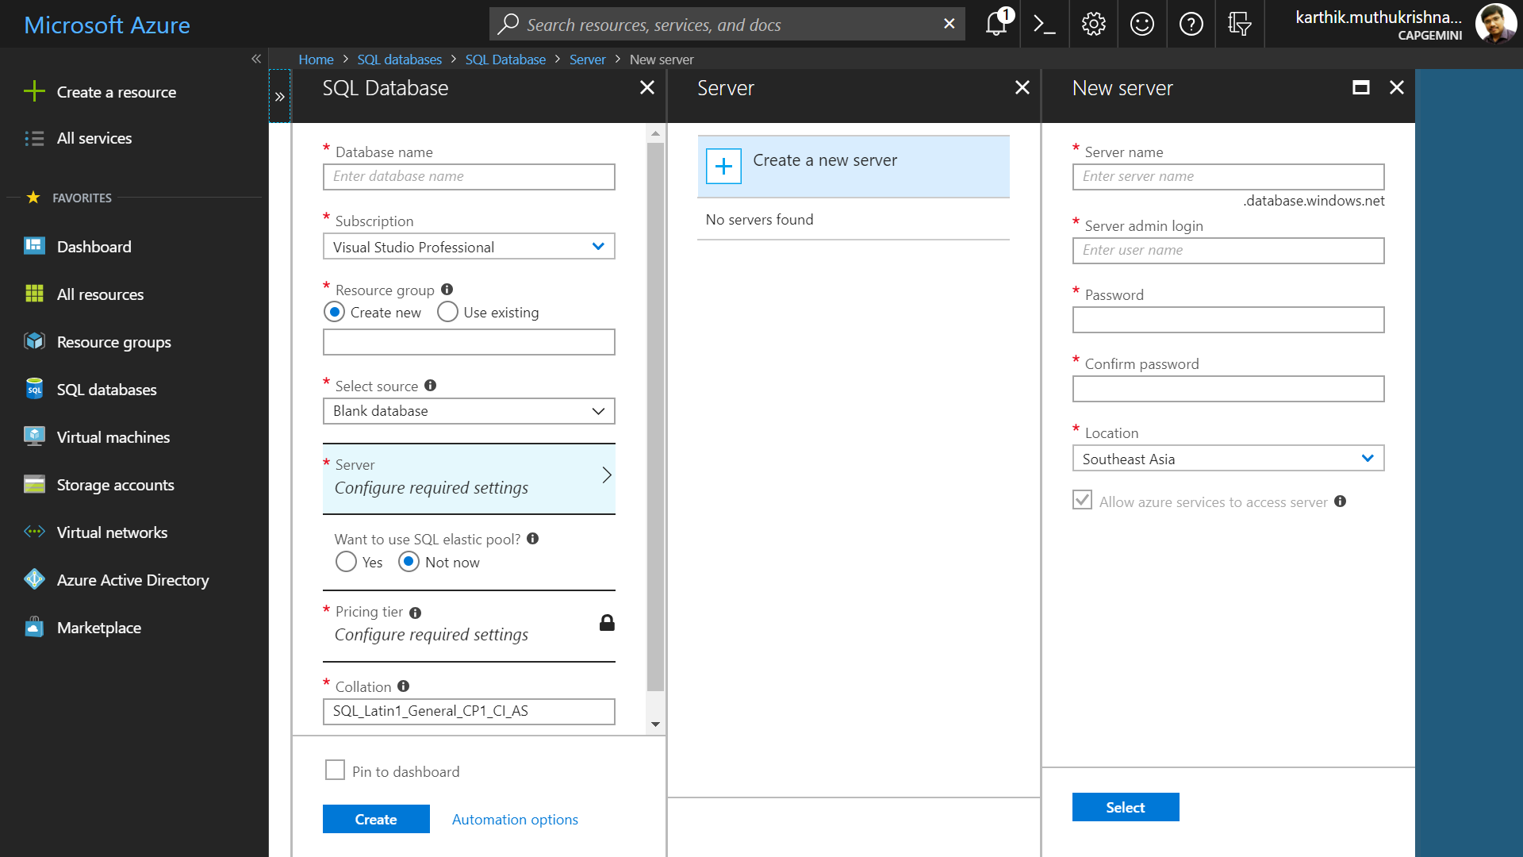
Azure Portal Navigation(Blades)

Slide 39
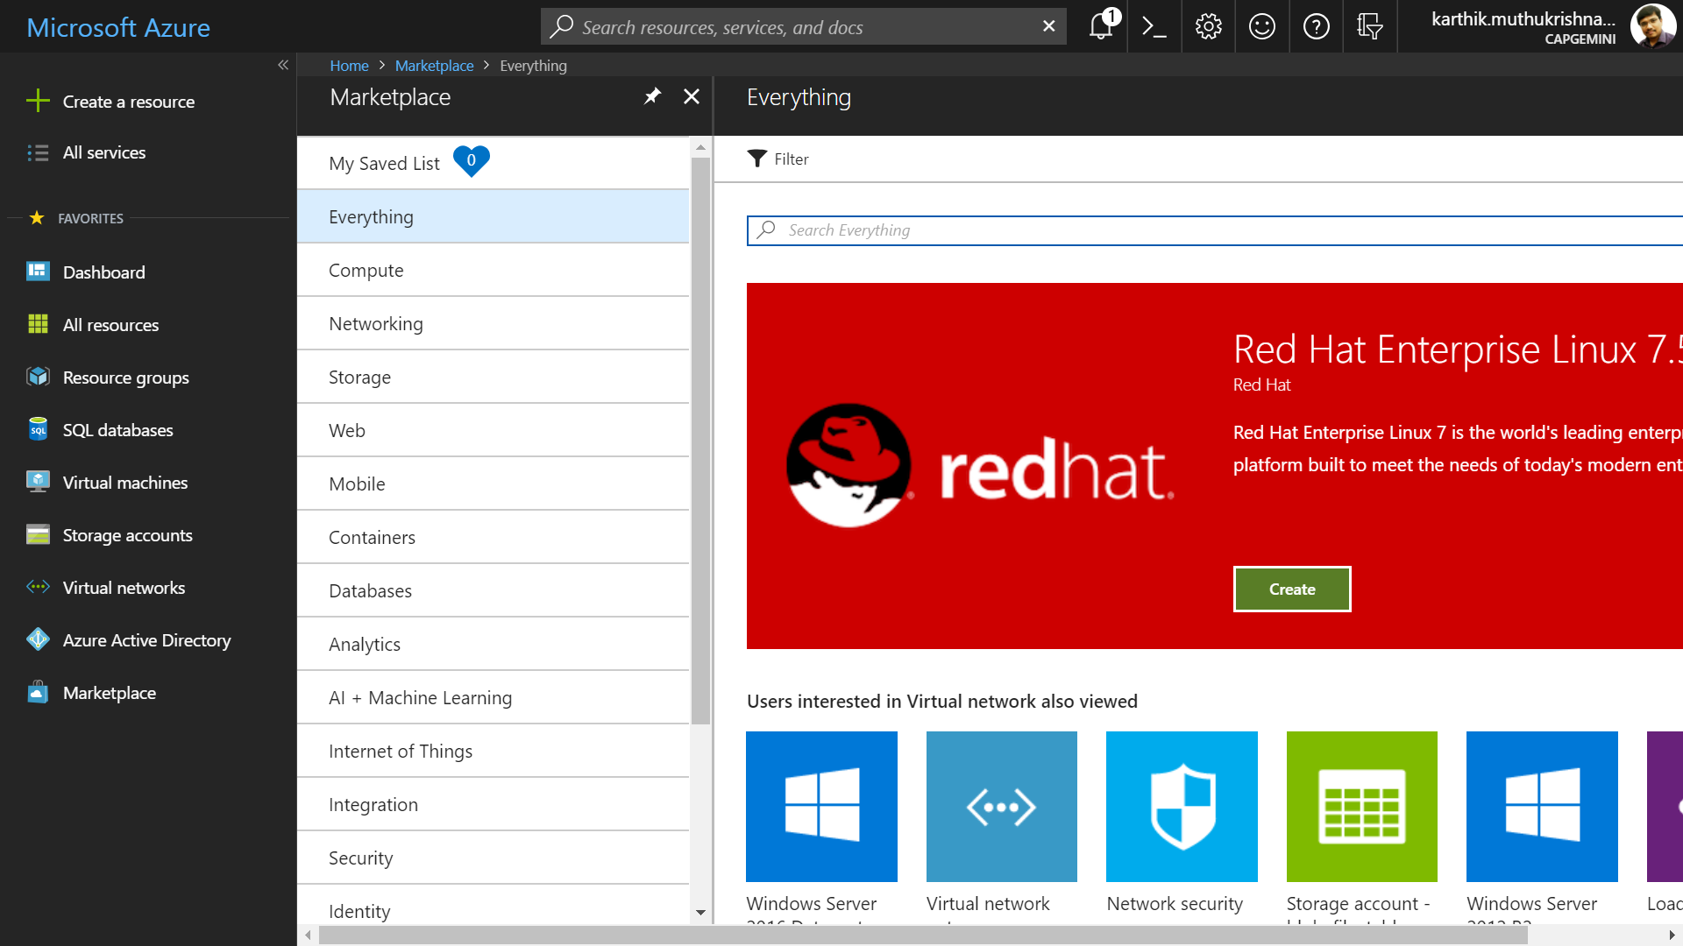
Azure Marketplace

Slide 40
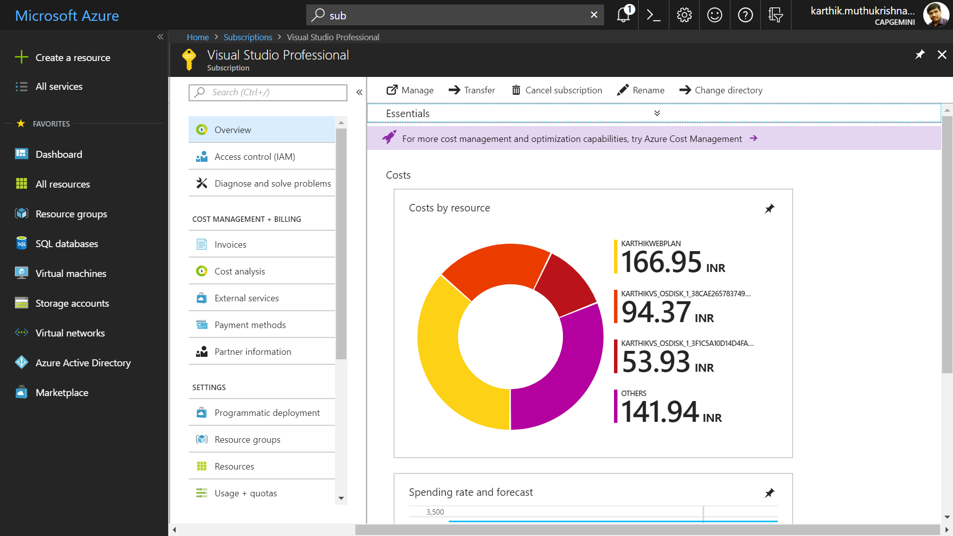
Azure Subscription Details

Slide 41
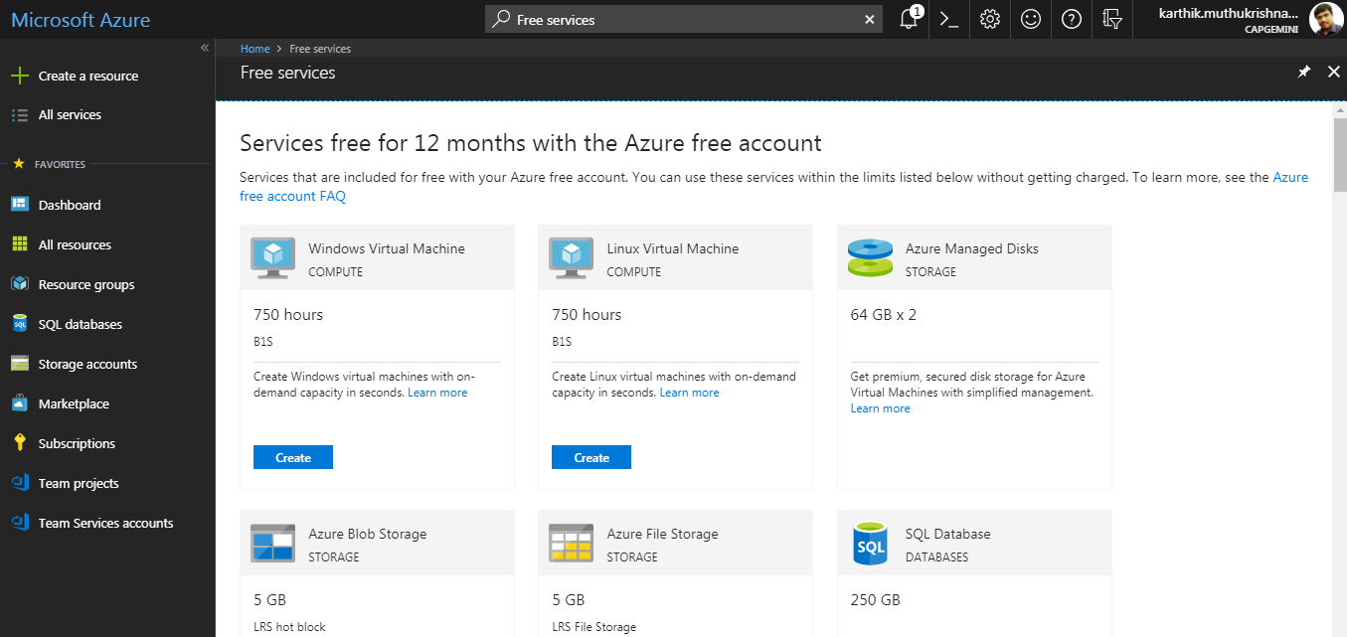
Azure Free Services

Slide 42
Azure Developer Tools
Although Azure portal is a great way to work with Azure resources, Microsoft offers a comprehensive set of development tools for any developer using any platform or language to deliver cloud applications.
Tool | Description
Visual Studio | Get all the power and capabilities you need to easily develop, debug, deploy, manage and diagnose cloud-scale applications on Azure, using a full-featured IDE
Visual Studio Code | Edit and debug code quickly with a lightweight code editor that runs on macOS, Linux and Window streamlined for building and deploying Node.js and Java apps to the cloud using serverless computing, containers or managed Web Apps
SDKs | Download and install language-specific SDKs and tools for your platform of choice, including .NET, Java, Node.js, Python and Go
CLIs | Use a Azure CLI / PowerShell command-line interface to create and manage services and automate everyday tasks in Azure
REST APIs | REST APIs allow us to interact with nearly every type of resource in Azure programmatically
Notes:
It is introduced as Windows Azure and renamed as Microsoft Azure in 2014.
With Azure, you get the freedom to build and deploy wherever you want, using the tools, applications, and frameworks of your choice. You can store data using relational SQL databases, NoSQL table stores, and unstructured blob storages, and optionally use Hadoop and business intelligence services to data-mine it. You can take advantage of Microsoft Azure’s robust capabilities to enable scalable distributed applications, as well as deliver hybrid solutions that run across a cloud and on-premise enterprise environment.
Microsoft Azure can provide a bridge from your data center to the cloud.

Slide 43
Summary
Microsoft Azure is an open, flexible, enterprise-grade cloud computing platform
Azure gives customers the flexibility to deploy applications where they need to, by providing more global regions than any other cloud provider
Using Azure Portal you can view and manage all your applications in one unified hub and stay on top of the things that matter most by pinning them to your dashboard

